Slide 1
Revolutionizing Decentralized Trading with Sunpump Integration
A Tron-Based Platform for Seamless, Low-Cost Trading
AIBlockgroup.io
Date

Slide 2
The Challenges in Decentralized Trading
High transaction fees and liquidity issues.
Complex user interfaces and poor user experience.
Limited integration with existing blockchain ecosystems.
Need for a more efficient and user-friendly platform.

Slide 3
Introducing Our Tron-Based Trading Platform
A secure, scalable, and user-friendly trading platform on the Tron blockchain.
Integration with Sunpump to reduce transaction costs and enhance liquidity.
Real-time trading experience with an intuitive interface.

Slide 4
Capturing the Growing Crypto Market
Expanding market for decentralized trading platforms.
Competitive advantage of using Tron’s low-cost and high-speed blockchain.
Target audience: retail traders, institutional investors, and crypto enthusiasts.

Slide 5
Key Features of Our Platform
User Authentication: Secure login, 2FA, and wallet integration.
Trading Engine: Real-time order matching and trade execution with advanced options.
Wallet Integration: Support for TRX and TRC20 tokens with real-time balance updates.
Sunpump Integration: Lower fees and enhanced liquidity management.
Dashboard: User-friendly interface showing balance overview, market data, and transaction history.
Admin Panel: Comprehensive tools for user management and transaction monitoring.

Slide 6
Robust and Scalable Technology
Frontend: React for a responsive user interface.
Backend: Node.js with Express.js for handling API requests and blockchain interactions.
Blockchain: TronWeb for smart contract interaction on the Tron blockchain.
Database: MongoDB for storing user data and transaction history.

Slide 7
Development Roadmap
Milestone 1: Setup and Configuration (1-2 weeks)
Milestone 2: Smart Contract Development (3-4 weeks)
Milestone 3: Backend Development (3-4 weeks)
Milestone 4: Frontend Development (4-5 weeks)
Milestone 5: Testing and QA (2-3 weeks)
Milestone 6: Deployment and Launch (1-2 weeks)
Total Estimated Time: 15 weeks

Slide 8
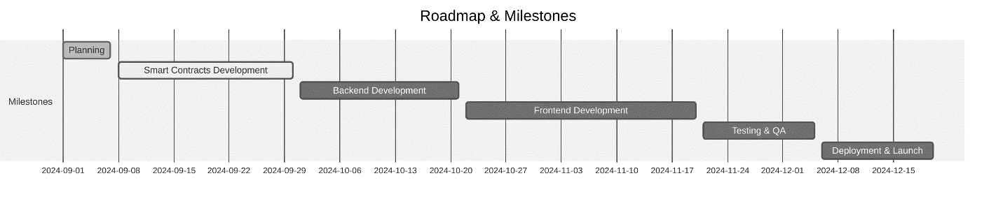
Road Map And Milestones

Slide 9
Launch and Growth Strategy
Focus on partnerships with Tron wallet providers and crypto exchanges.
Marketing strategy targeting retail and institutional traders.
Community engagement through social media and crypto forums.
Plan for post-launch support and continuous updates.

Slide 10
Revenue and Growth Projections
Expected revenue streams: trading fees, premium features, and staking rewards.
Projected user growth and platform adoption.
Financial forecast for the first 3 years post-launch.

Slide 11
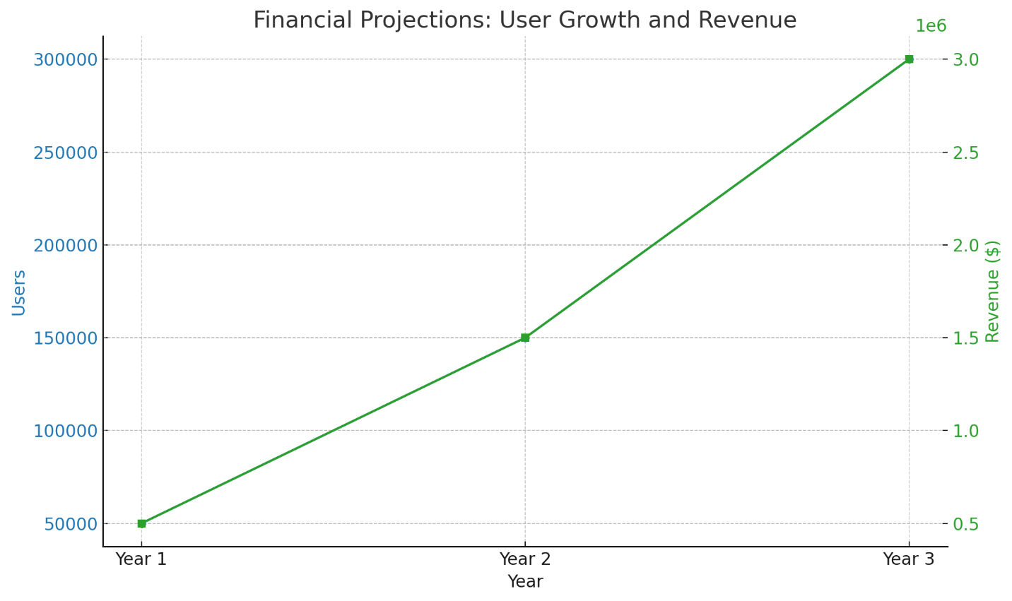
System Architecture Diagram from Tech Spec Doc

Slide 12
Join Us in Revolutionizing Decentralized Trading
Summarize the investment opportunity.
Clearly state the funding requirements and what the funds will be used for.
Invitation to schedule a meeting or contact for further discussion.

Slide 13
Let's Connect
Dave Dobbins, AIBlockgroup.io, and contact details.
Links to website and social media profiles.
https://aiblockgroup.io/
https://www.linkedin.com/in/davedobbins/

